Slide 1


Slide 2


Slide 3

Introduction Our Travel Agency Database, the cornerstone of our seamless and customer-centric travel services..
Seamlessly connecting travelers, destinations, and services, our database offers effortless booking of flights, hotel reservations, and tailored packages.
With user-friendly interfaces for customers and expert support from travel agents and employees, your journey is in capable hands.
Experience the convenience of secure payments, personalized options, and data-driven improvements, all united to make your travel unforgettable.
Discover a world of seamless travel planning and embark on journeys crafted just for you, powered by our Travel Agency Database.

Slide 4
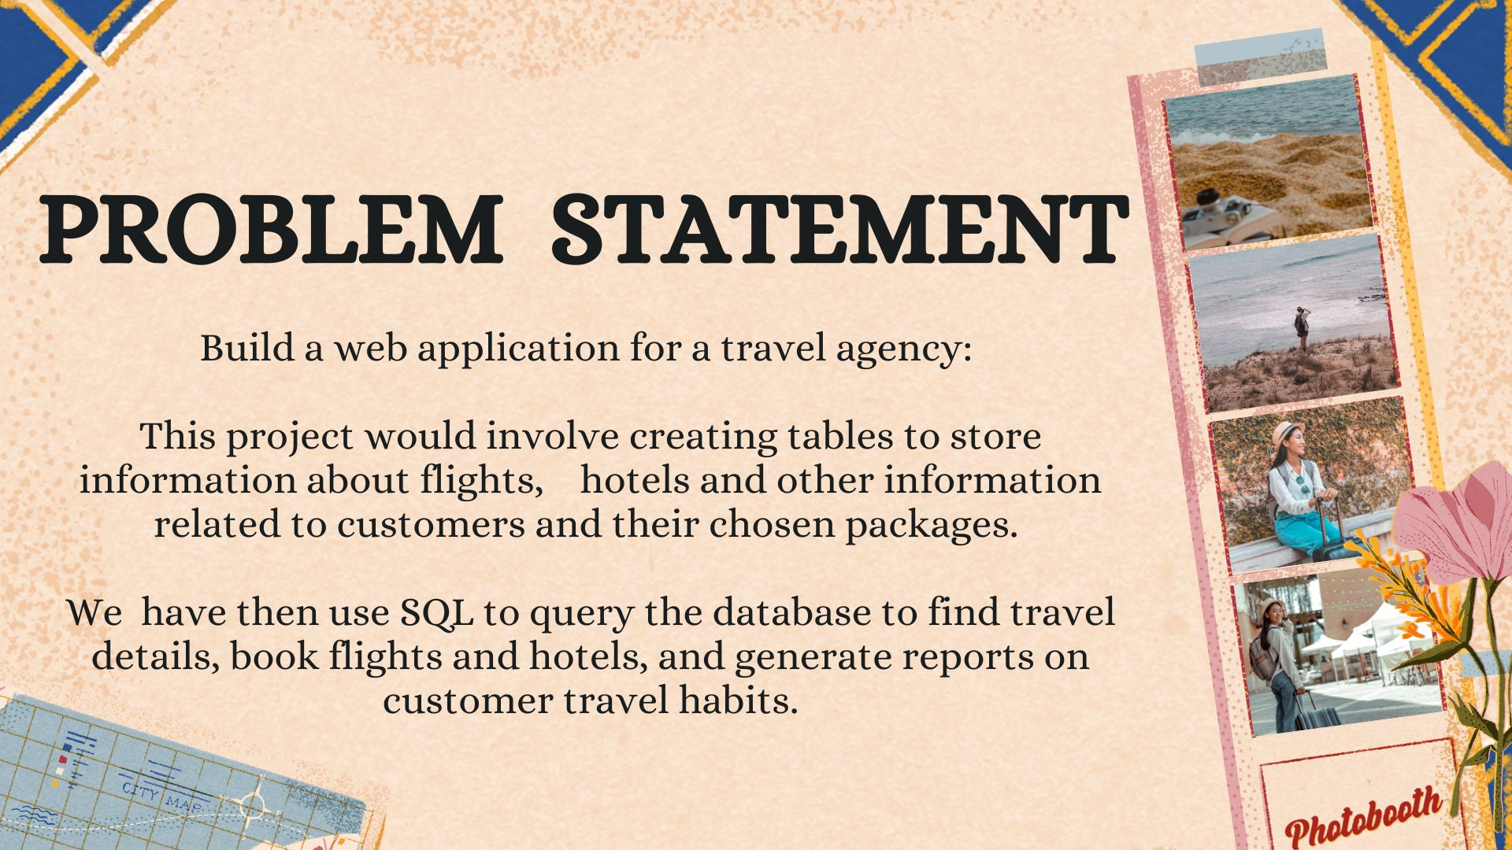

Slide 5


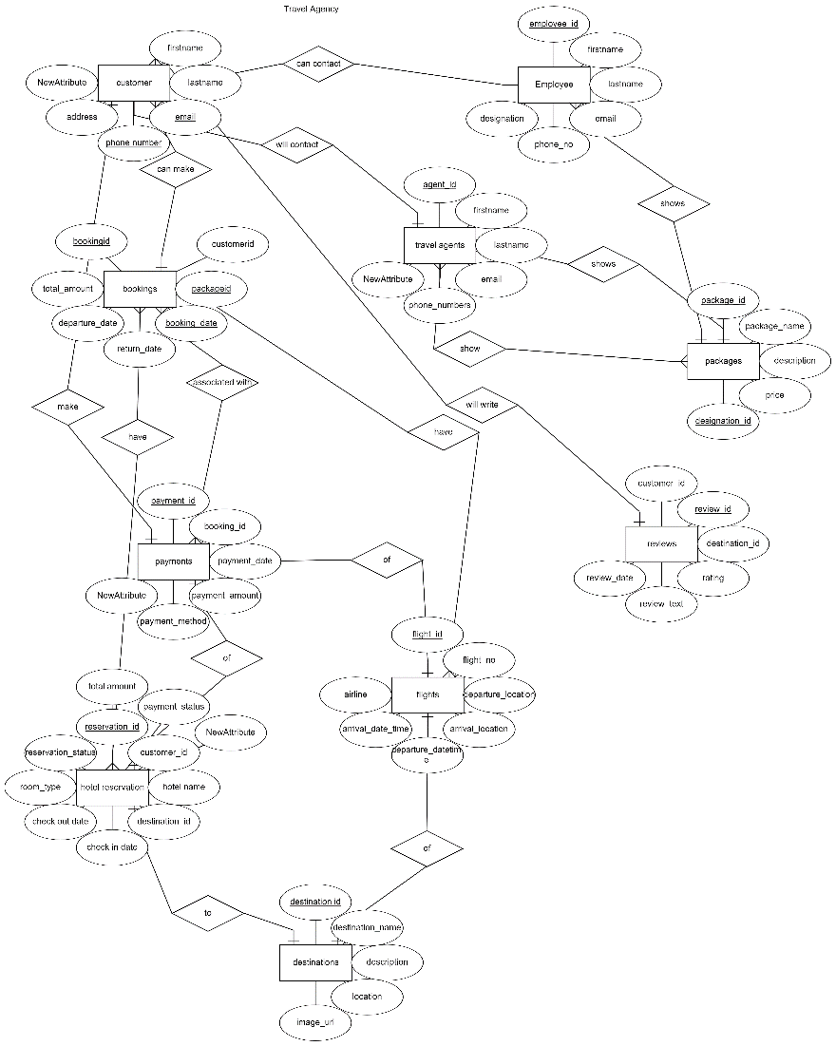
Entity Relationship –(ER)Diagram
Through creating an ER (Entity-Relationship) diagram for our travel agency we have visualized the entities (tables), their attributes (fields), and the relationships between them.

Slide 6
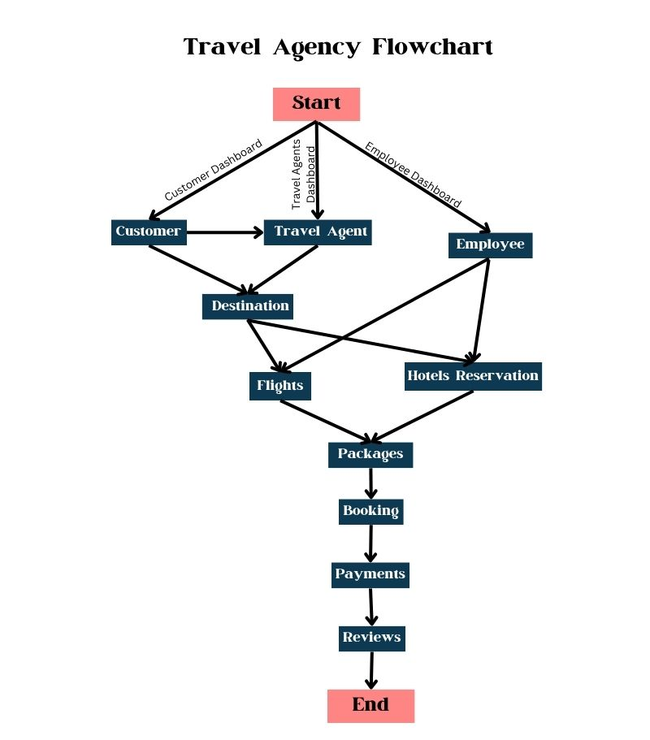

Slide 7
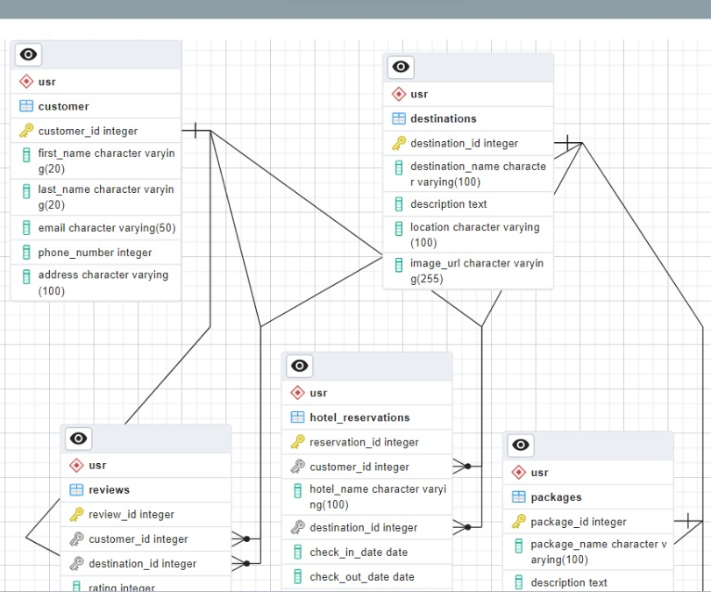
Entity Relationship Diagram (ERD)Table

Slide 8
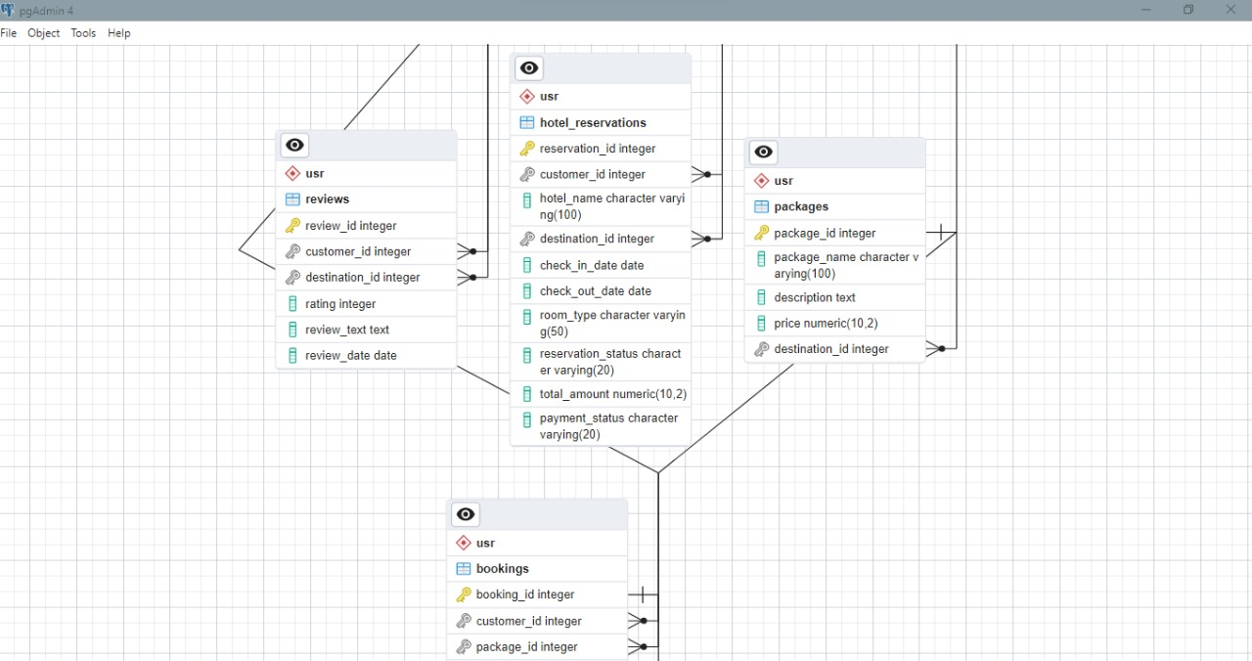
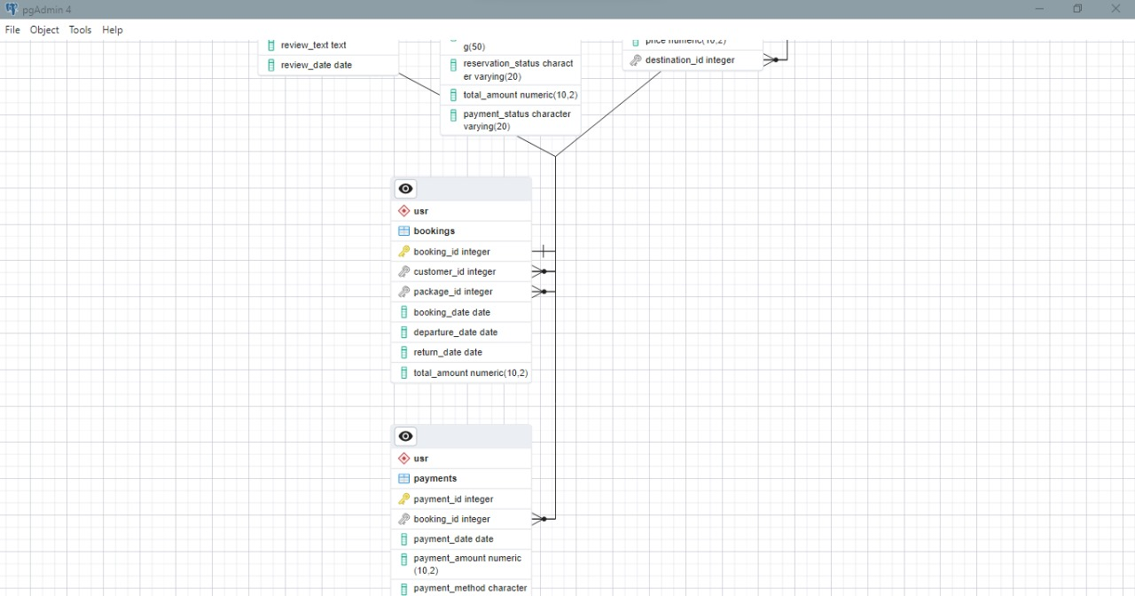
Entity Relationship Diagram (ERD)Table

Slide 9
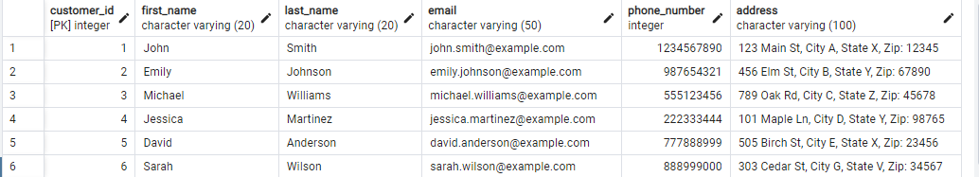
Tables of our Database
Customer’s Table
Description
The "Customers" table in our travel agency database serves as the foundation for personalized and efficient travel experiences. It encompasses essential customer details to ensure seamless interactions and tailor-made services
Customers table has the following attributes:
Customer ID (Primary key)
First_name
Last_name
Email
Phone_number
Address

Slide 10
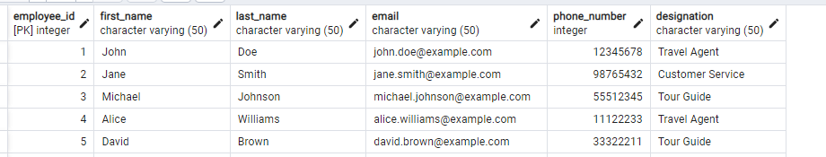
Employee’s Table
Description:
The "Employee" table in our travel agency database holds pivotal information about our staff members.Our Table comprises of the following attributes:
Employee_id(Primary key)
First_name
Last_name
Email
Phone_number
Designation
By maintaining these attributes within the "Employee" table, we establish a foundation for efficient employee management, ensuring that our team is equipped to provide exceptional customer service, handle inquiries, and facilitate smooth travel arrangements.

Slide 11
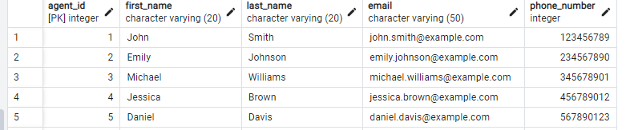
Travel Agents' Table
Description:
The “Travel Agent’s" table in our travel agency comprises of the following attributes:
Agent_ID(Primary key)
First_name
Last_name
Email
Phone_number
By maintaining these attributes within the "Travel Agents" table, we establish a platform for delivering expert advice, personalized guidance, and top-notch customer service. Our dedicated team of travel agents is equipped to assist customers with their travel plans, offering insights and recommendations to create memorable journeys.

Slide 12
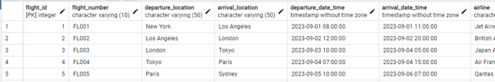
Flights' Table
Description:
The “Flight’s" table in our travel agency comprises of the following attributes:
Flight_ID(Primary key)
Flight_number
Departure_Location
Arrival_Location
Departure_Date_Time
Arrival_Date_time
Airline
By housing these attributes within the "Flights" table, we create a foundation for efficient flight management, enabling customers to explore flight options, select suitable itineraries, and make informed travel decisions. This data also allows us to facilitate smooth booking processes and provide accurate information to travelers.

Slide 13
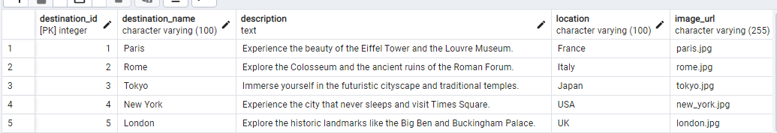
Destinations' Table
Description:
The “Destination’s" table in our travel agency comprises of the following attributes:
Destination_ID(Primary key)
Destination_name
Description
Location
Image_url
By maintaining these attributes within the "Destinations" table, we create a comprehensive resource for customers to explore and select their desired travel locations. This data empowers customers to make informed decisions based on descriptions, images, and location details, ensuring that their travel experiences are enriched and well-informed.

Slide 14
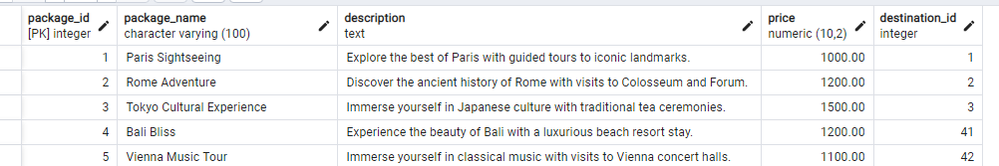
Packages' Table
Description:
The “Package’s" table in our travel agency comprises of the following attributes:
Package_ID(Primary key)
Package_name
Description
Price
Destination_id(Foreign key)
By maintaining these attributes within the "Packages" table, we create an organized and accessible repository of travel experiences. This data empowers customers to review package details, compare offerings, and make well-informed decisions based on their preferences, ensuring that their travel plans align with their desires and expectations.

Slide 15
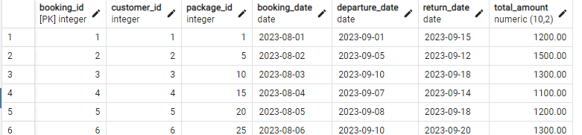
Bookings' Table
Description:
The “Bookings’ table in our travel agency comprises of the following attributes:
Booking_ID(Primary key)
Customer_ID(Foreign key)
Package_ID (Foreign key)
Booking_Date
Departure_Date
Return_date
Total_amount
By housing these attributes within the "Bookings" table, we create a central repository for tracking and managing customer reservations. This data facilitates smooth communication, itinerary planning, and ensures that both customers and staff have a clear overview of travel arrangements.

Slide 16
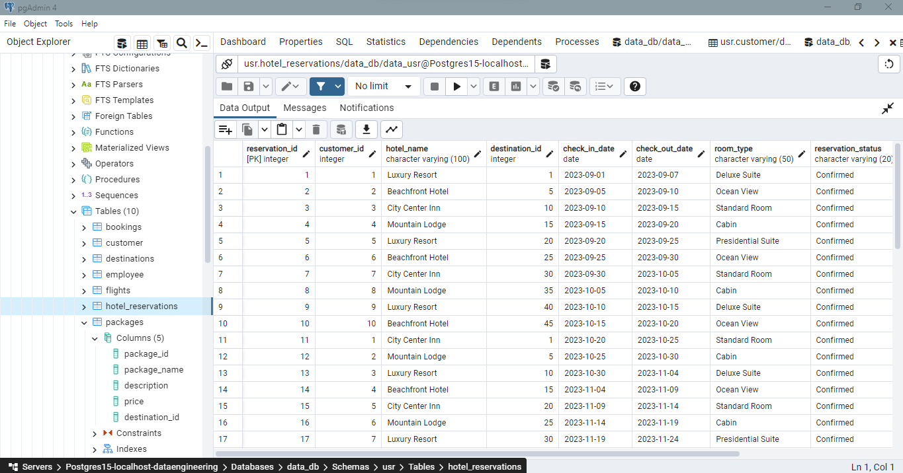
Hotel Reservations' Table
Description:
The “Hotel Reservations’ table in our travel agency comprises of the following attributes:
reservation_id ,
customer_id ,
hotel_name ,
destination_id ,
check_in_date ,
By maintaining these attributes within the "Hotel Reservations" table, we create a central repository for managing and coordinating hotel stays. This data facilitates smooth guest experiences, efficient planning, and ensures that both customers and hotel staff have accurate and updated information regarding reservations and accommodations
check_out_date ,
Room_type ,
reservation_status ,
total_amount
payment_status

Slide 17
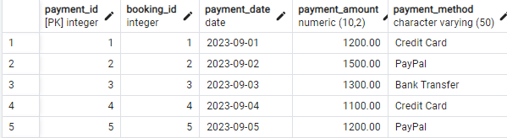
Payments' Table
Description:
The “Payments’s" table in our travel agency comprises of the following attributes:
Payment_ID(Primary key)
Booking_ID(Foreign key)
Payment_Date
Payment_amount
Phone_method
By maintaining these attributes within the "Payments" table, we establish a structured and comprehensive record of financial interactions. This data ensures that payments are accurately tracked, bookings are properly accounted for, and customers receive transparent and reliable financial information related to their travel arrangements.

Slide 18
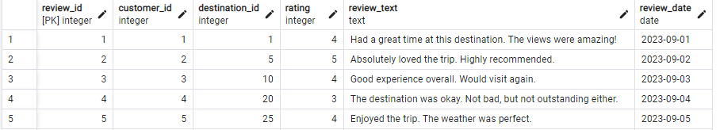
Reviews' Table
Description:
The “Reviews" table in our travel agency comprises of the following attributes:
Review_ID(Primary key)
Customer_ID(Foreign key)
Destination_id(Foreign key)
Rating
Review_text
Review_date
By maintaining these attributes within the "Reviews" table, we create a valuable resource for monitoring customer sentiments and improving services. This data empowers our travel agency to make informed decisions, address concerns, highlight positive experiences, and continuously enhance the quality of our offerings based on the feedback provided by our valued customers.

Slide 19
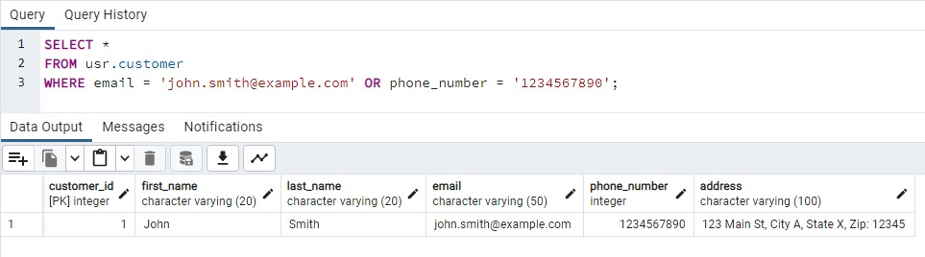
SQL – Queries
SQL Query 1: Retrieve Customer Details by Email or Phone Number
This query retrieves customer information based on either their email or phone number, allowing efficient search and access to customer details for personalized communication and assistance.

Slide 20
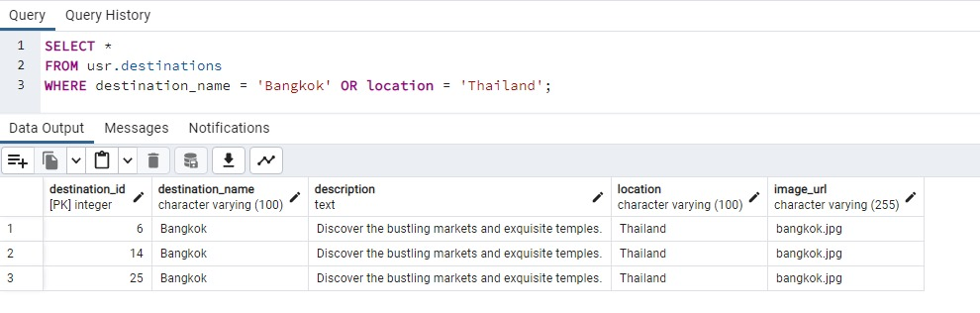
SQL – Queries
SQL Query 2: Retrieve Destination Details by Name or Location
This query fetches destination information based on either the destination name or its geographical location. It enables quick access to destination details for travel planning, package customization, and customer inquiries.
This query retrieves customer information based on either their email or phone number, allowing efficient search and access to customer details for personalized communication and assistance.

Slide 21
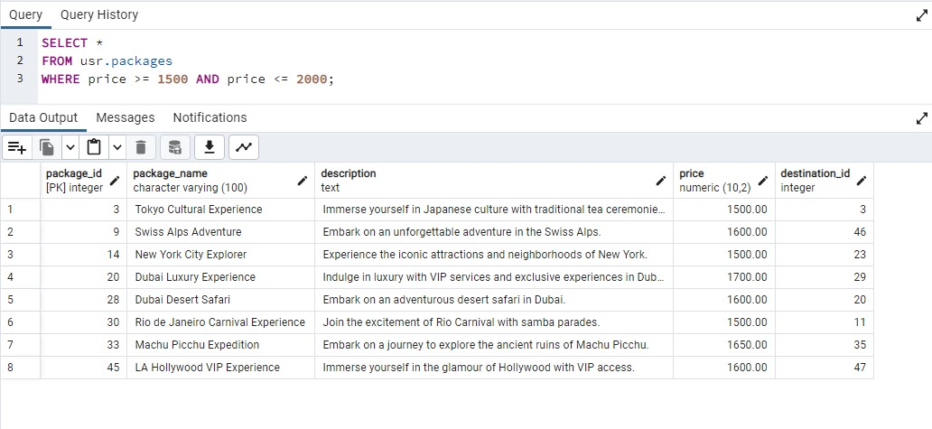
SQL – Queries
SQL Query 3: Retrieve Packages within a Price Range
This query retrieves packages that fall within a specified price range, enabling customers to explore travel options that match their budget and preferences.

Slide 22
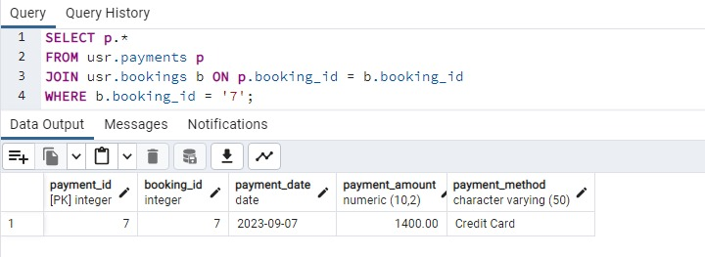
SQL – Queries
SQL Query 4: Fetch All Payments for a Specific Booking
This query retrieves all payment transactions associated with a particular booking. It provides a comprehensive overview of financial interactions related to the booking, ensuring transparency and accurate record-keeping.

Slide 23
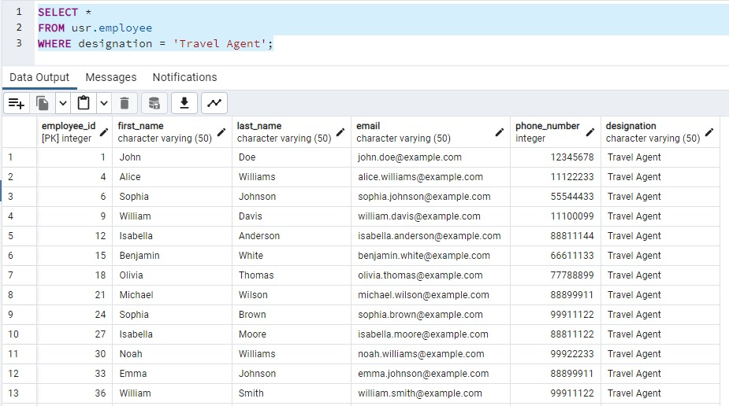
SQL – Queries
SQL Query 5: Retrieve Employee Details by Position
This query retrieves employee information based on their assigned position, allowing easy access to details of employees holding specific roles within the travel agency's workforce.

Slide 24
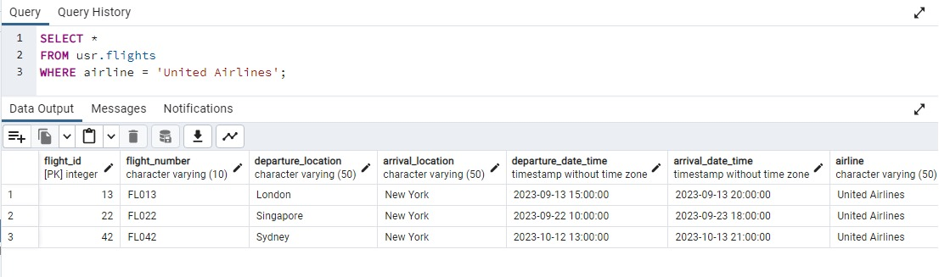
SQL – Queries
SQL Query 6: Fetch Flights by Airline
This query retrieves flight information based on the specified airline, enabling customers and staff to access flight details operated by a particular airline for travel planning and booking purposes..

Slide 25
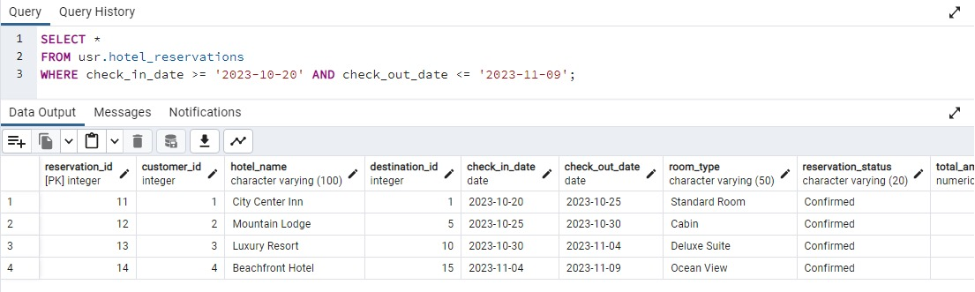
SQL – Queries
SQL Query 7: Get Reservations within a Date Range
This query retrieves reservations made within a specified date range, facilitating the identification of bookings scheduled within a particular time frame for efficient management and planning.

Slide 26
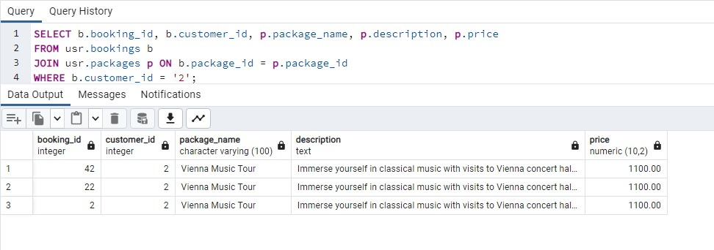
SQL – Queries
SQL Query 8: Get Bookings and Associated Package Details for a Specific Customer
This query retrieves all bookings made by a particular customer, including the details of the associated packages. It offers a comprehensive view of the customer's travel history and the packages they've chosen for their trips.
In this case, the query is retrieving booking information along with associated package details for a specific customer. The "JOIN" is performed between the "bookings" table and the "packages" table based on the common column "package_id".

Slide 27
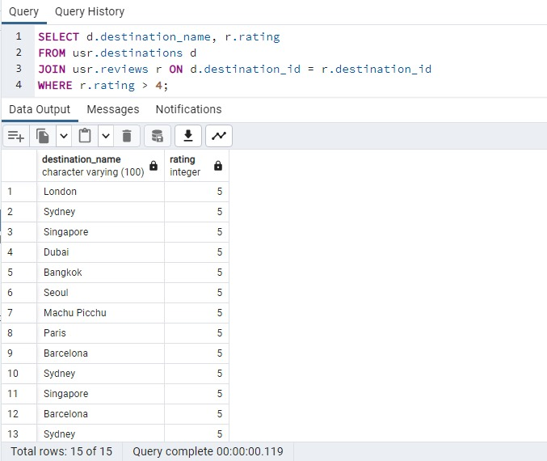
SQL – Queries
SQL Query 9: Retrieve Destinations with High-Rated Reviews
This query demonstrates the power of "JOIN" operations by retrieving destinations that have received reviews with ratings surpassing a certain value. By combining the "destinations" and "reviews" tables, we can identify and showcase destinations that have garnered positive feedback from customers. This allows us to emphasize well-received travel options and provide valuable insights to potential travelers.

Slide 28
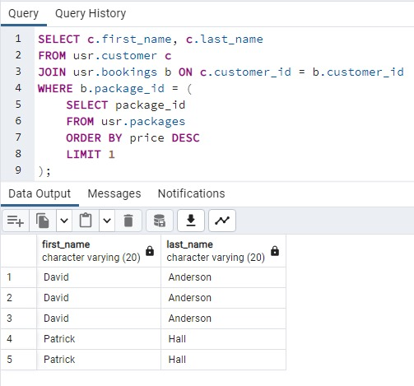
SQL – Queries
SQL Query 10: Identify Customers with Top-Priced Package Bookings
This query leverages data integration through "JOIN" operations to discover customers who have booked the highest-priced package. By combining customer, booking, and package information, it highlights those who prefer premium travel experiences. This insight guides personalized offerings and enhances customer satisfaction.

Slide 29
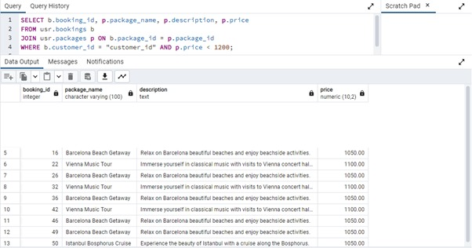
SQL – Queries
SQL Query 11: Get Affordable Package Bookings for a Specific Customer
This query combines customer, booking, and package data to retrieve bookings made by a specific customer, where the associated package price is less than $1200. It provides insights into budget-friendly travel choices for the customer, enhancing their travel planning experience.

Slide 30
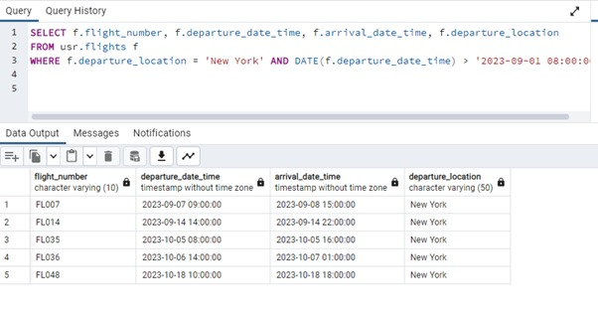
SQL – Queries
SQL Query 12: Retrieve Upcoming Flights from a Specific Location
This query utilizes flight data to retrieve a list of flights departing from a designated location after a given date. By focusing on departure details, it assists travelers in identifying flights that align with their preferred location and travel schedule.

Slide 31


